Slide 1
Shower Survey
Conducted by:
Group 9
Jehu Barbee, Eric Botelho, Ashley Famularo, Grady Landers
Michael Medeiros

Slide 2
Introduction
Tasked with the creation of a survey revolving around the showering habits of students
University wanted to figure out a way to reduce the amount of money spent and conserve water by reducing shower times of students
Entire surveying process was a 3 phase assignment
Phase 1:
Producing the initial version of the survey
Distributing it to the first focus group
Reworking the initial version of the survey with the focus group feedback
Phase 2:
Distribute the reworked version of the survey to the next group of 100 people
Attempt to reach an additional 900 surveyees
Phase 3:
Analysis of the data with the 9 statistical measures
Presenting the findings to the class
Hypothesis: Freshmen and sophomores who live on campus will take shorter showers because they share community bathrooms/showers, but juniors and seniors will take longer showers as they have private bathrooms.

Slide 3
II. The Survey
The Outline:
Initial brainstorming document of the survey
Slightly over 1 page in length
Breaks down what it will cover:
Defines what the primary objective of the survey will be
Suggests possible lengths of the survey
Suggests possible questions (and their choices if in multiple-choice format)
Basic info of participant (Age, Gender, Major, etc.)
Shower related numerics (Avg. per week, avg. length)
Version 1:
Produced via the above
9 questions in length
Includes a brief feedback section for the surveyee
One major discrepancy was question structure
Questions using fill-in where multiple-choice would be more useful
Others having generally confusing wording
Notes:
Talk about the various confusing questions:
“Do you partake in physical activities such as sports or exercising at the gym?”
“If you are a resident, what resident hall are you reside in?”

Slide 4
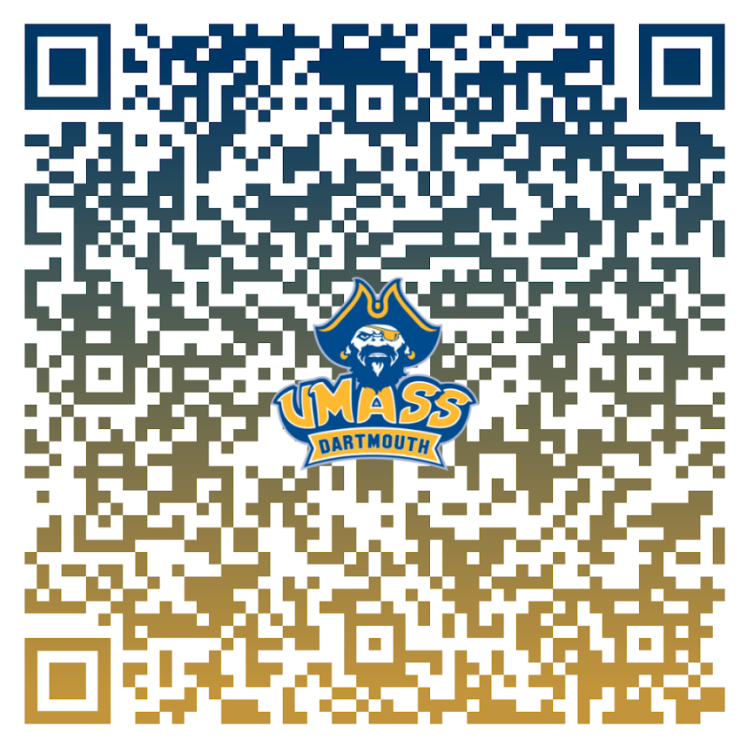
II. The Survey
Version 2:
Initial rework produced during the latter of Phase 1
Various tweaks to question wording were done
“Do you partake in physical activities such as sports or exercising at the gym?” was changed to “Do you use the gym on campus or play any sports?”
Various tweaks to question format were done
Changed the fill-in to multiple choice for “If you are a resident, what resident hall do you reside in?”
Increased question length from 9 to 11
Version 3:
Final version produced for Phase 2
Increased question length from 11 to 12
Biggest change was the distribution method
Transferred to a Google Forms version
A QR Code was produced that acted as a link to the survey
Produced code can be seen in the bottom right (Figure 1)
Figure 1
Notes:
Talk about the additional questions:
For Version 2:
“Do you shower at the gym/other places besides your resident hall?”
“Are there circumstances where you take longer than the time stated above?(i.e. sickness, long day, etc.)”
For Version 3:
“Do you think you could reduce the time of your shower by 1 (one) minute or more?”

Slide 5
III. The Results
From the initial focus group
Some questions were worded confusingly leading to miss representation in responses
In this iteration, almost everyone said they exercise, this was most likely a result of it being conducted face-to-face and the social pressure that adds
After the first phase and some tweaks to the survey
Easier to spread it amongst a larger population of people with the QR code rather than handing over a device
Collected more information about what affects their shower times
Made it less confusing and quicker to fill out

Slide 6
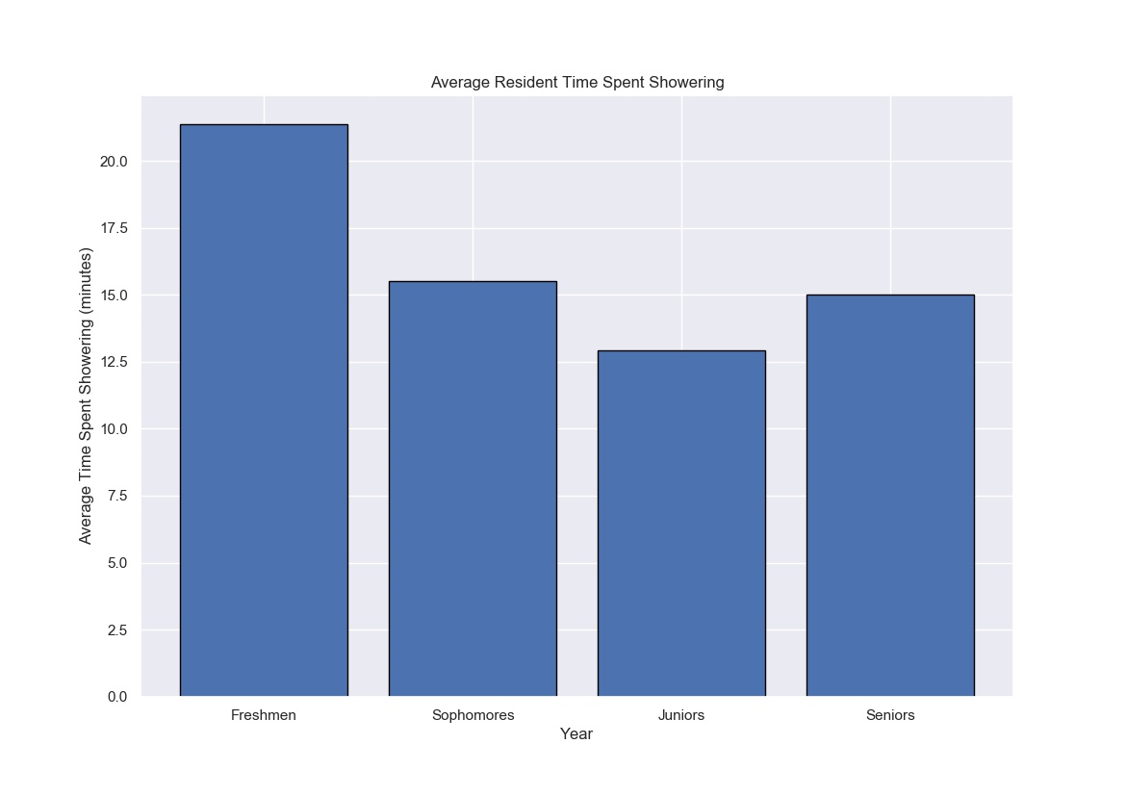
III. The Results
The following visual (Figure 2) is made from the results from phase 2
Used to demonstrate our overall hypothesis
It shows the average time a person in each year of study spends showering
A freshman student spends a little over twenty minutes in the shower
While a junior student spends just barely over twelve and a half minutes in the shower
Figure 2

Slide 7
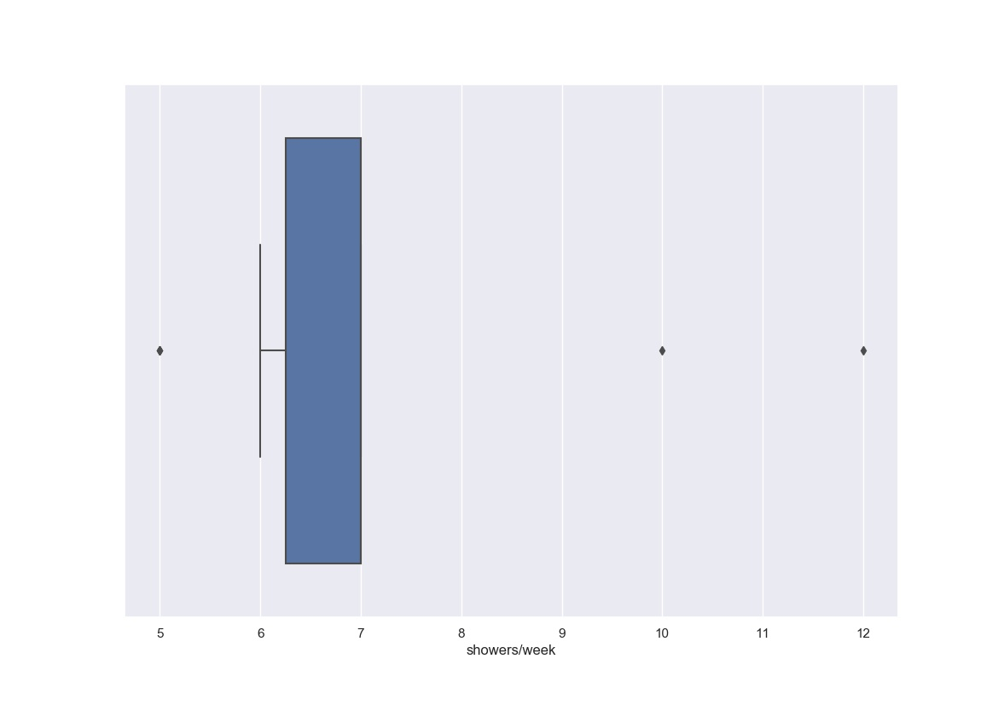
IV. Analysis/Findings
From Phase 1
Takers of the survey were confused by some of the questions
Commuters responding Yes to showering other places
Physical activities being too broad of a question
Not gathering more personal data
To show where the answers are coming from
What might affect their total number of showers and time spent in the shower
We were getting more commuters than residents
Average number of showers hovered around 7 a week
Figure 3

Slide 8
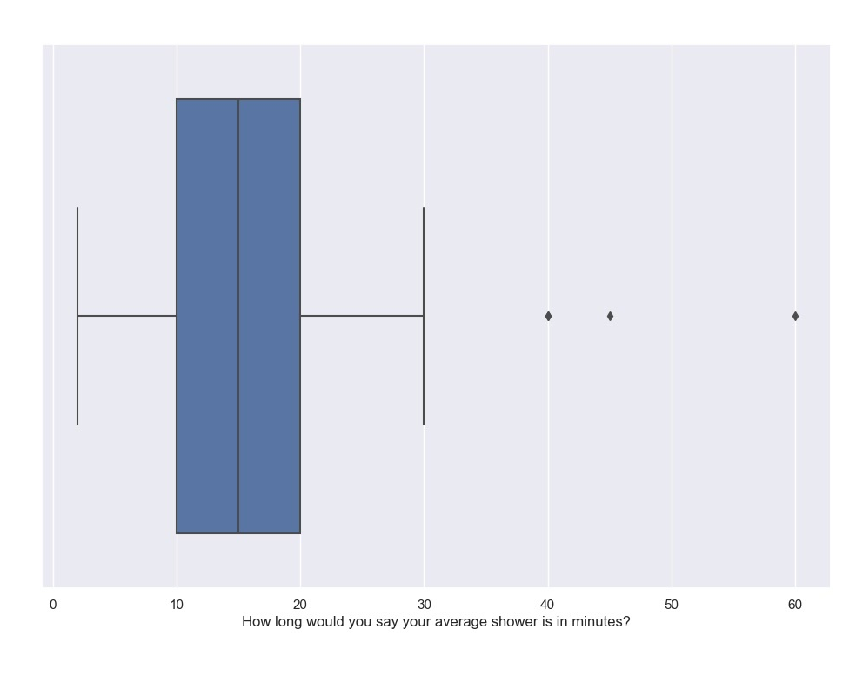
IV. Analysis/Findings
From Phase 2
People who spend about fifteen minutes showering
Willing to reduce time by one minute
People who spend about twenty minutes
Not willing to reduce time by one minute
Those twenty and younger
Tend to take longer in the shower
But time decreases with age - a negative correlation
Freshmen tend to take the longest showers
The average shower time is about fifteen minutes long
Figure 5

Slide 9
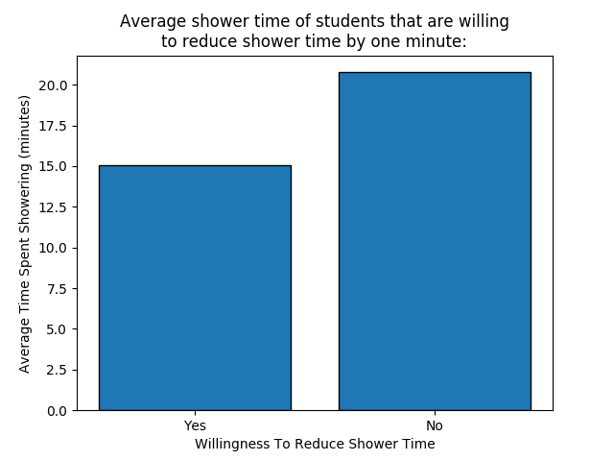
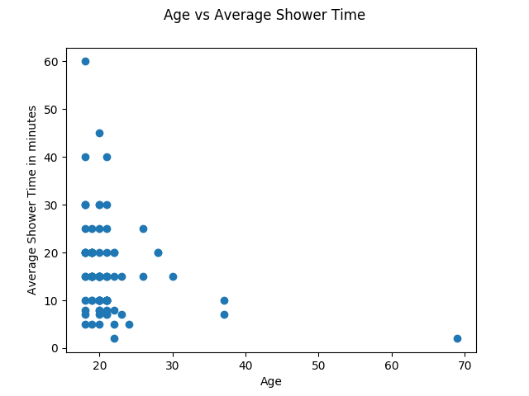
Figure 6
Figure 7

Slide 10
V. Recommendations
Giving brief “guide” handout for students
Can be used to understand how to track shower time
Such as using music or other various methods
Display alternative showering methods that reduce water usage
An example would include the Navy or staggered shower
Allow them to understand why it is important to reduce their time
A possible inclusion would be the average amount of water saved by reducing your shower time by even a minute
Notes:
navy shower is a method of showering that allows for significant conservation of water and energy by turning off the flow of water in the middle portion of the shower while lathering

Slide 11
VI. Conclusion
Our hypothesis was disproved
Freshmen and sophomores took the longer showers in comparison to juniors and seniors
Could be because both freshmen and sophomores don’t know as many people on campus, thus wanting to make better impressions by not smelling/looking better.
Juniors and seniors may take shorter shower because they have more to do as they are further involved in their studies, as well as possibly being more comfortable with themselves/having more things to do (homework, jobs, etc)
Displayed in Figure 2
Survey produces a bias for residents over commuters
Not only results, but from questions
Several of the questions ask about on campus activities with few dealing with other items off-campus
Fixed questions don’t account for other factors that could affect shower time
Thus does not provide a sufficient conclusion
Notes:
Elaborate as to why it is not sufficient - yes results are produced by the factors on the survey are not covering enough.
Some items could not be asked as they are too personal, like do people have underlying health conditions that could result in the different shower times
or their housing situation results in lesser showers the situation more being focused on commuters since their conditions when they get home were not talked about

